Slide 1
>> SLIDE 1
Promoting Interventions for Community Living
Wednesday, Sept. 22 2:00 – 3:30 p.m. CT
Kelsey Goddard & Keshia Walker
Notes:
Kelsey

Slide 2
>> SLIDE 2: Acknowledgement
The contents of this presentation were developed under a grant from the National Institute on Disability, Independent Living, and Rehabilitation Research (NIDILRR grant number 90RT5043). NIDILRR is a Center within the Administration for Community Living (ACL), Department of Health and Human Services (HHS). The contents of this presentation do not necessarily represent the policy of NIDILRR, ACL, HHS, and you should not assume endorsement by the Federal Government.
Notes:
Kelsey

Slide 3
>> SLIDE 3: What is PICL?
Research and Training Center on Promoting Interventions for Community Living (RTC/PICL)
Partnerships with four Centers for Independent Living:
disABILITY LINK (Tucker, Georgia)
The Ability Center (Toledo, Ohio)
Voices for Independence (Washington, Pennsylvania)
accessABILITY (Indianapolis, Indiana)
Notes:
Kelsey

Slide 4
>> SLIDE 4: What is PICL?
The “PICL program” consists of two consumer-directed programs designed for people with mobility disabilities:
The Home Usability Program
Goal-setting program to make a person’s home more usable
Out and About Program
Goal-setting program related to community participation
Overall goal:
To increase the community participation of people with mobility disabilities
Notes:
Keshia
Collaborative research project between the UK and UM that helps assist individuals with physical disabilities to identify and address barriers that they may face both in their homes and in their communities.

Slide 5
>> SLIDE 5: What is PICL?
To evaluate the effects of the PICL program on community participation, CIL consumers participated in a research study
What did participants do?
Review and sign informed consent document
Take surveys about their health, homes, and activities
Participate in the two PICL programs:
Home Usability Program
Out and About
Take surveys about their health, homes, and activities – again!
Participate in an interview
Notes:
Keshia
HUP and OAA provided documents to consumers to allow them to track their progress, identify barriers in their living space and community, and self-advocate for themselves along their journey.

Slide 6
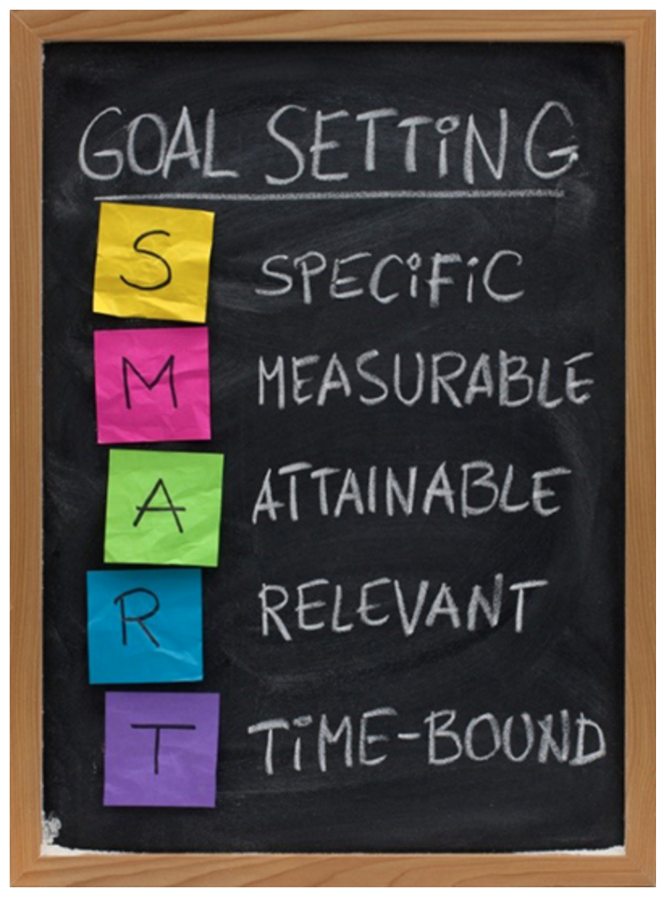
>> SLIDE 6: Home Usability Program
http://useablehome.ri.umt.edu
Steps of the Home Usability Program (HUP)
Create a Home Usability Program Plan
Home Assessment (Consumer or Professional)
Set a SMART Goal
Relates directly to the person and their home
Aims to positively effect function or access
Notes:
Kelsey
KW – include picture of SMART table?

Slide 7
>> SLIDE 7: Home Usability Program
Usability Problem | HUP Solution
Difficulty cleaning floors | Roomba electronic vacuum
Difficulty using tub/shower | Grab bars, long handheld showerhead, shower bench, non-slip mat
Goals must relate directly to the person and the home:
Reduce fatigue
Increase/conserve energy
Improve safety
Improve sleep quality
Alleviate pain
Increase independence
Improve access
Notes:
Kelsey

Slide 8
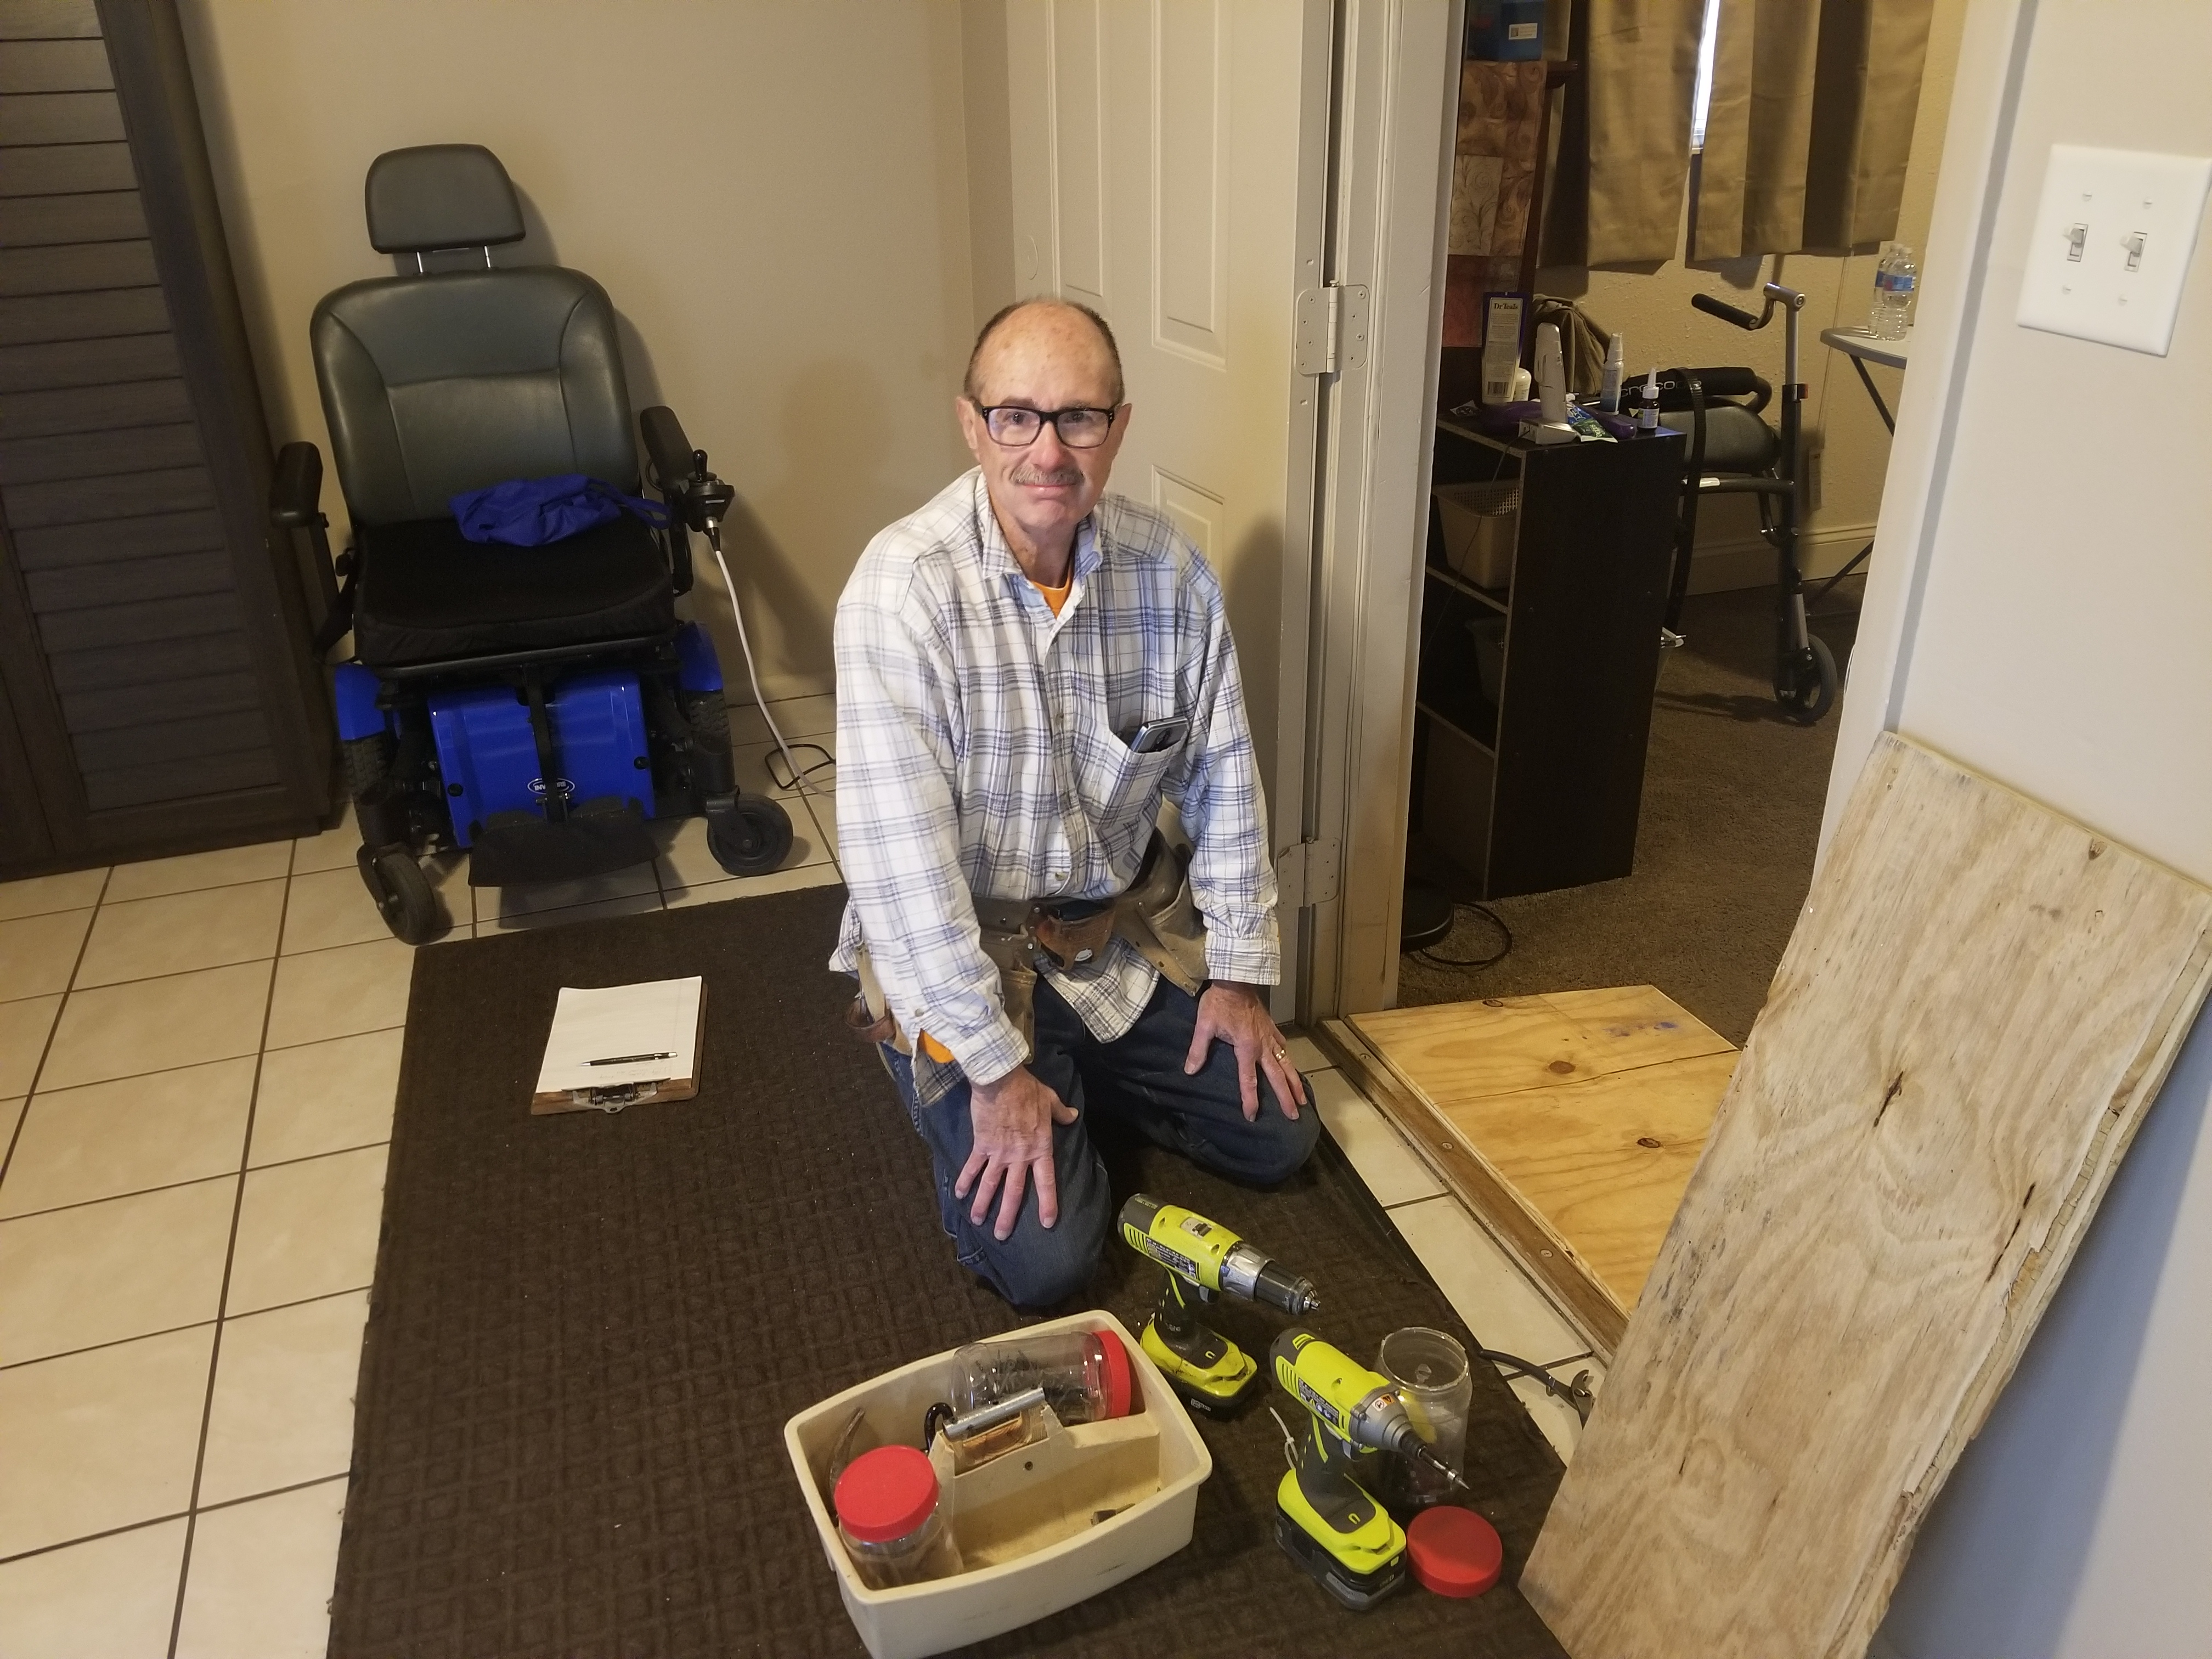
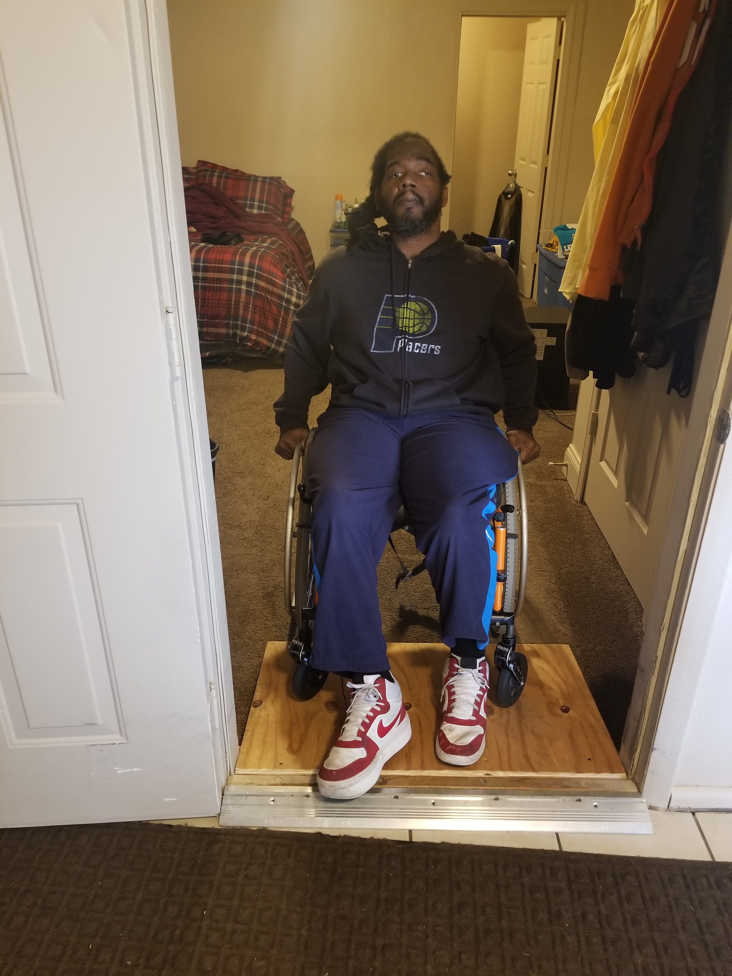
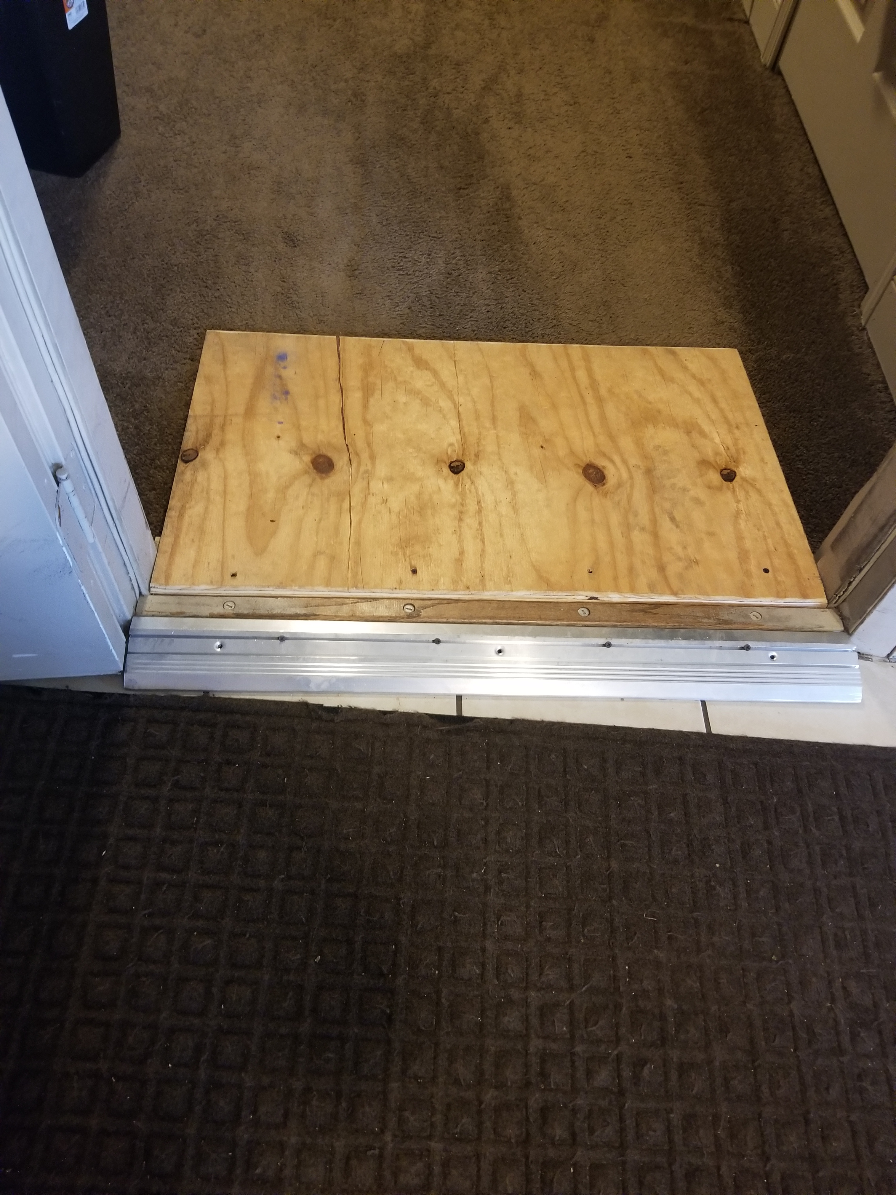
>> SLIDE 8: Home Usability Program Scenarios
Notes:
Kelsey
Image 1 – Don installing ramp in home
Image 2 – consumer accessing room for first time?
Image 3 – completed installation – such an easy fix for such a huge impact!

Slide 9
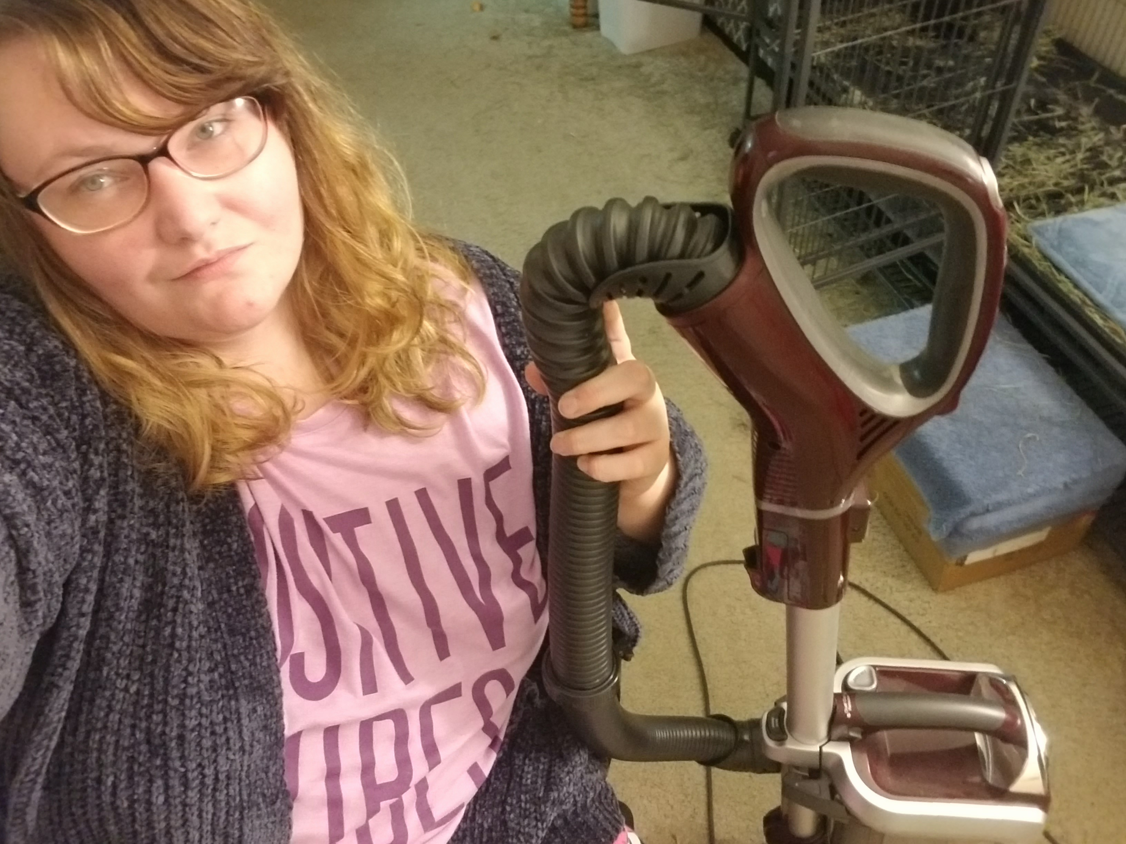
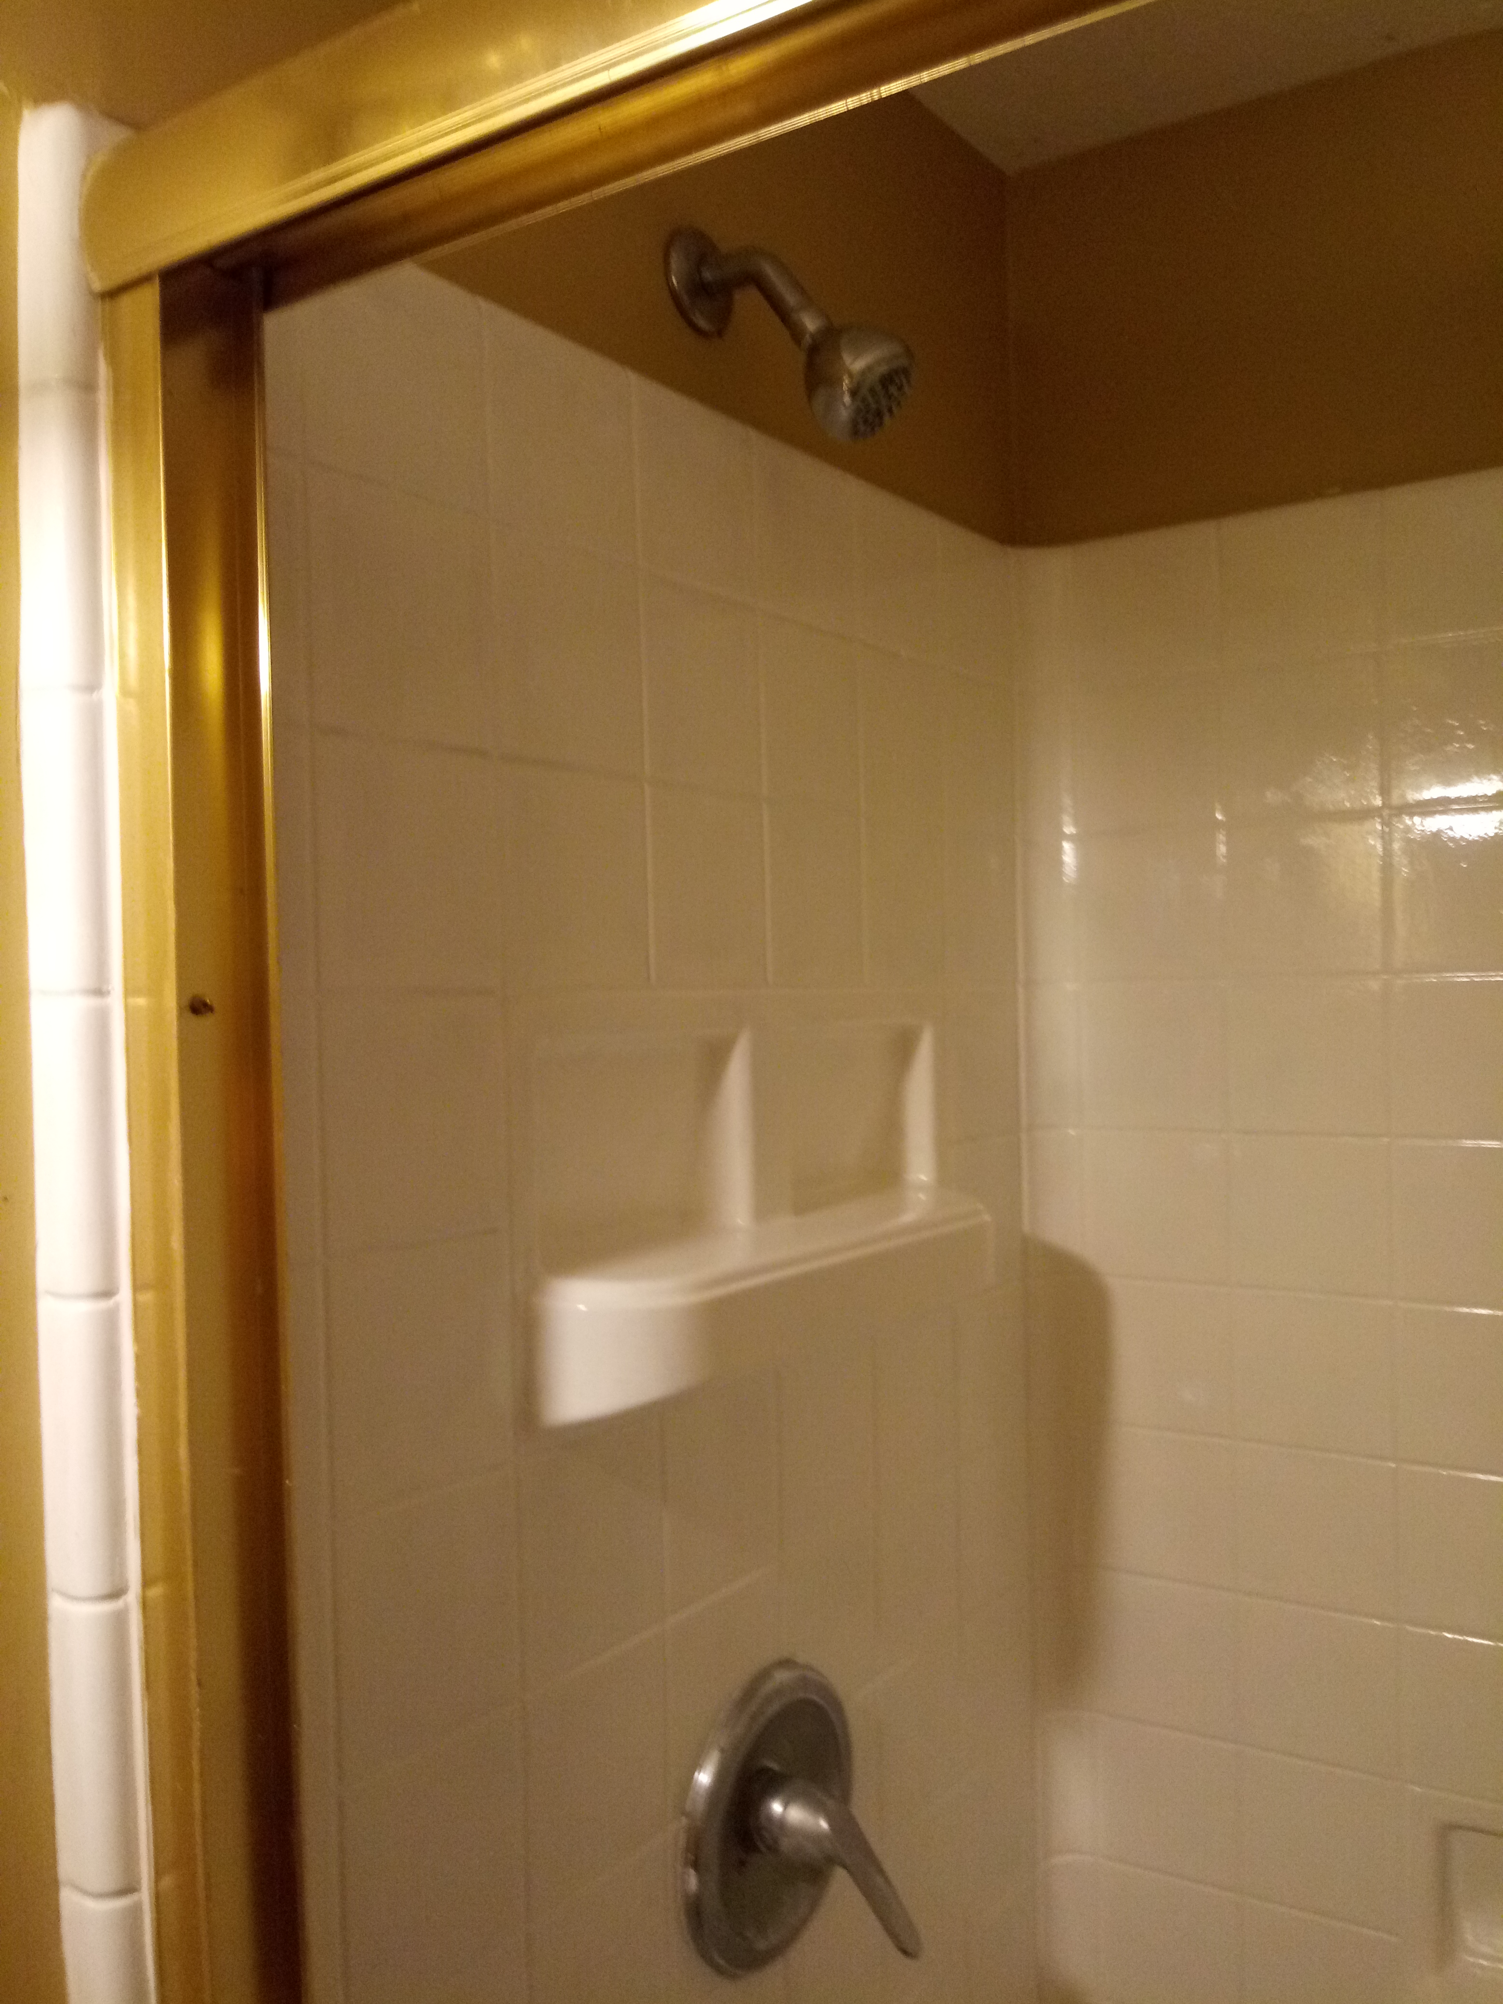
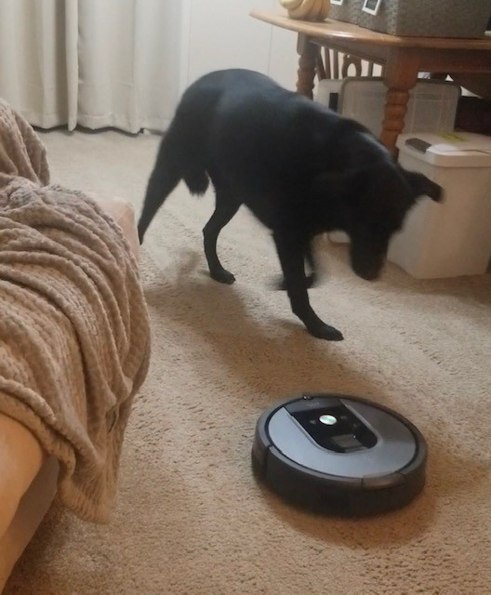
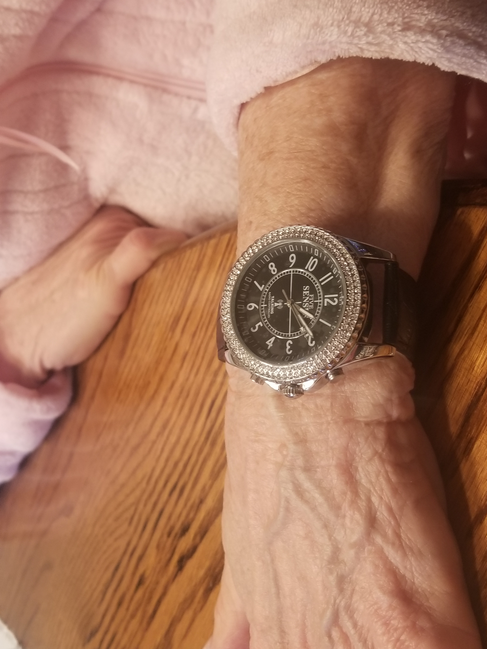
>> SLIDE 9: Home Usability Program Scenarios
Notes:
Kelsey – Keshia was studying research at IUPUI – and her CIL advocate asked if she would like to participate in a research study (they both shared their struggles with using a vacuum while using their wheelchairs I.e. cord gets wrapped in tires)– and that’s how she got connected with PICL program

Slide 10
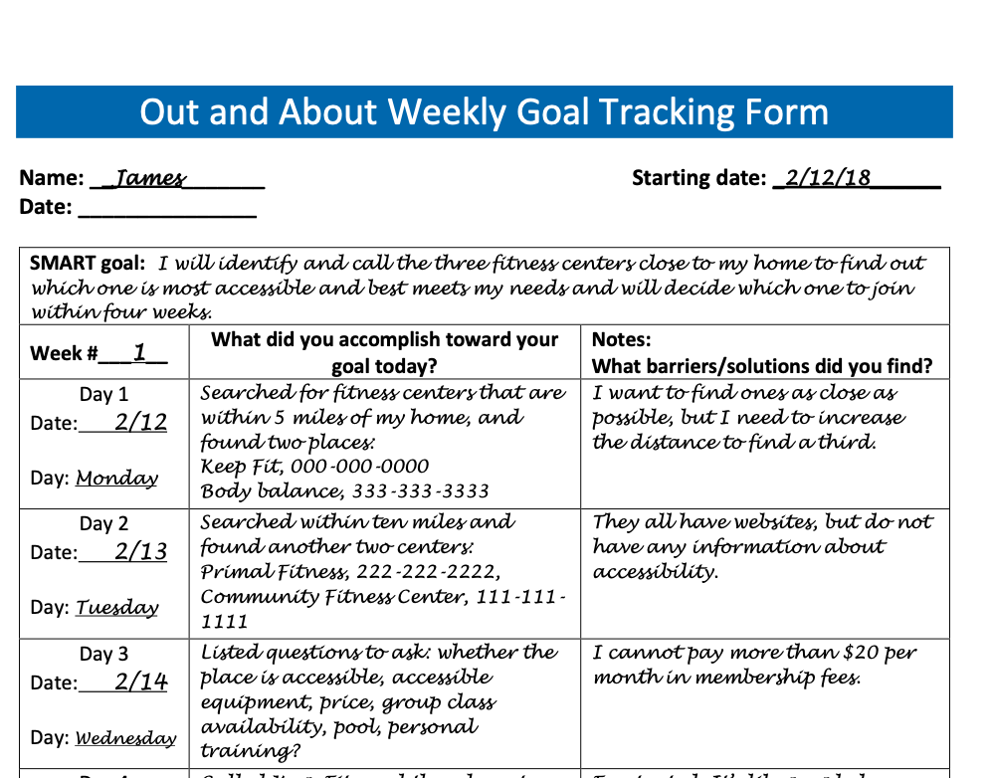
>> SLIDE 10: Out and About
https://outandabout.ctb.ku.edu
Steps of the Out and About (OAA) program:
Choose a Goal
Set a SMART Goal
Track Goal Progress
Review and Celebrate
Notes:
Keshia
Tracking Form image, give example of type of goal

Slide 11
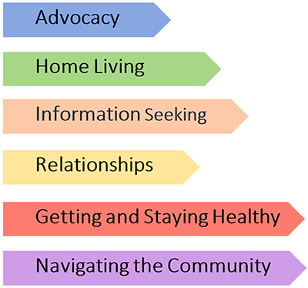
>> SLIDE 11: Out and About
Goal Area | OAA Goal
Getting healthy | Going to the gym and identifying supports to join them
Transportation | Using the paratransit system for the first time
Notes:
Keshia
Resouces per goal setting category
To help ppl to select diff goals, we provided a varity of resources for the following categories to help them set and work towards their goals.

Slide 12
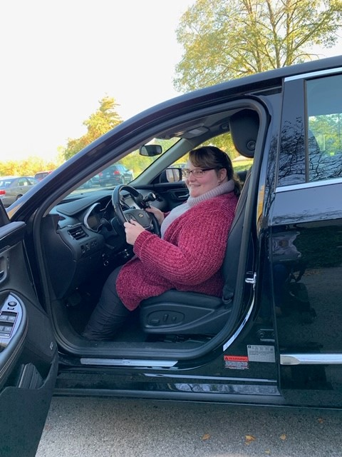
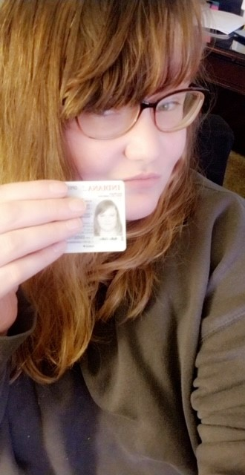
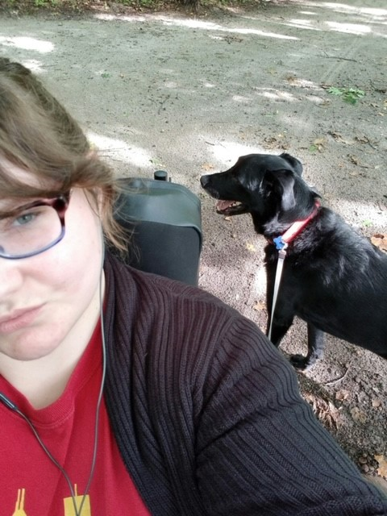
>> SLIDE 12: Out and About Scenarios
Notes:
Keshia – verbally describe photos
Image 1: first time sitting behind the wheel of a vehicle. CIL advocate drove me to appointment and took the image.
Image 2: The day receiving my driver's license
Image 3: Drove myself and my service dog to local park where we hiked around the woods

Slide 13
>> SLIDE 13: PICL During the Pandemic
Implications of the coronavirus pandemic on PICL:
Measures of physical participation in the community not as meaningful
People electing not to physically participate in their community
Community participation as a “luxury”
More people in emergency crises during the pandemic
Increased attention to meet basic needs
Solutions:
Increased interviews to assess effects of PICL program on consumer’s lives
Pivot to “community participation from home”
Learning from CIL staff about the needs of their consumers
Notes:
Kelsey

Slide 14
>> SLIDE 14: Quotes about CIL staff
“I learned from [my CIL staff]… that I was a very prideful person. And when I let that go, I got help. I learned that I was not going to live my whole life with this invincible person that you think you are when you’re younger. I’m going to break down. I kept saying, I’m going to be 100 years old, running. That was my thing, I loved to run. And it didn’t work. But I learned that it’s okay. That is okay. That was one part of my life I’m moving into another part of my life, and I will be able to be viable in that part of my life as well.”
Notes:
Kelsey – more than just the participation in the program; doesn’t define your life

Slide 15
>> SLIDE 15: Home Usability Program Quotes
“[The Home Usability Program] kind of gave me a sense of, if I were to do even more accessibility modifications to my home, kind of the process… kind of what I would need to think about and go through, prior to making that happen. So, making sure I have the money set aside, obviously, but also contacting people, getting different estimates, and things like that.”
“I learned how to better ask some questions. I also learned that there are resources available that you might not initially think of.”
Notes:
Keshia – This project goes beyond what consumers actually accomplished during the programs – it’s what skills they learned / gained to keep moving forward.

Slide 16
>> SLIDE 16: Out and About Quotes
“So, I think definitely the best thing was just kind of the connection with other people. I feel like it really has for me, at least increased a little bit during this COVID-19 pandemic… we all want to make sure that we stay connected because it can get very lonely when you’re either by yourself or with the same group of people constantly.”
“[I learned] new information, learning about organizations that I didn't know were there. Kind of prompting me to actually do a little research of my own. Because otherwise I wouldn't have thought about looking up anything about food assistance or mobile meals or anything like that. So, it was good, excellent for information, because someday I may need it.”
Notes:
Keshia

Slide 17
>> SLIDE 17
Questions?
Notes:
Keshia – verbally describe

